Slide 1
EEC 130A Introductory Electromagnetics I
Lecture 18
Winter 2012
Dr. Xiaoguang “Leo” Liu
Electrical and Computer Engineering
UC Davis

Slide 2
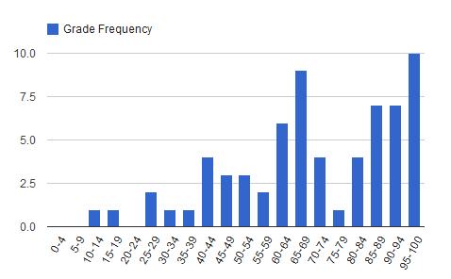
Announcements
Final exam schedule
Wednesday (Mar. 21): 3:30 – 5:30 pm, Wellman 234
Friday (Mar. 23): 3:30-5:30 pm, Haring, 1227
Midterm 2 Statistics
Average 52.9 and 21.2 (out of 75)
Std. Dev. 16.7 and 12.17 (out of 75)
70.5 and 42.4
(out of 100)

Slide 3
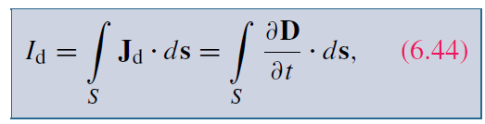
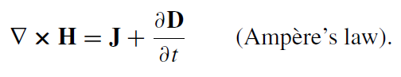
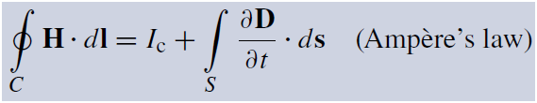
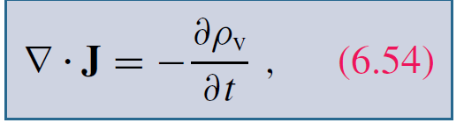
Review
Displacement current
Ampere’s law
Changing electric field induces magnetic field
Charge-current continuity

Slide 4
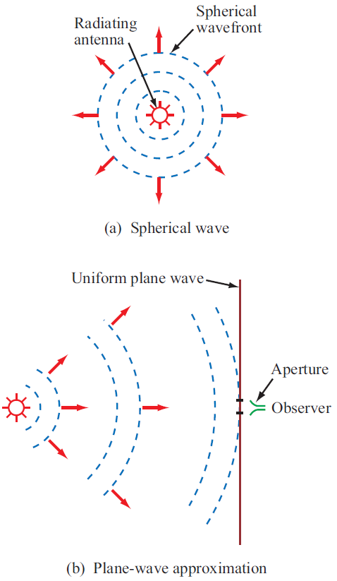
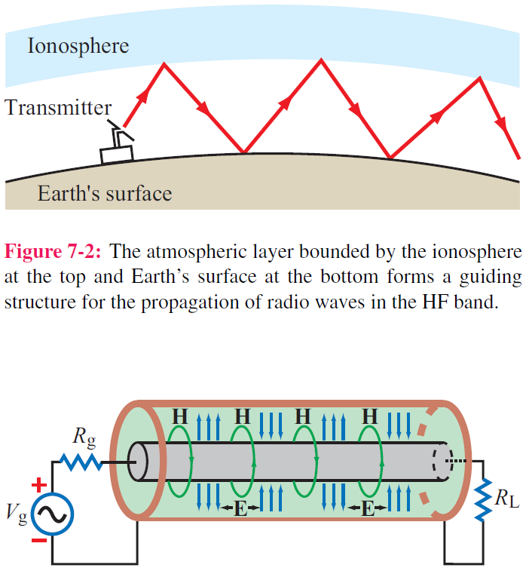
Electromagnetic Waves
Guided EM Waves
Unbounded EM Waves

Slide 5
Time-Harmonic Fields
E, D, B, H has sinusoidal variation in time

Slide 6
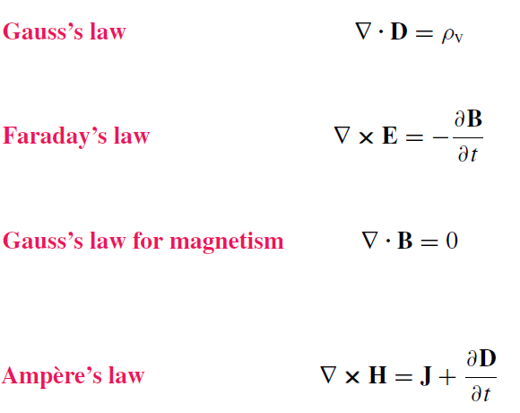
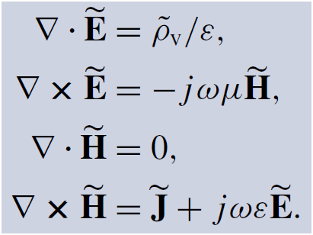
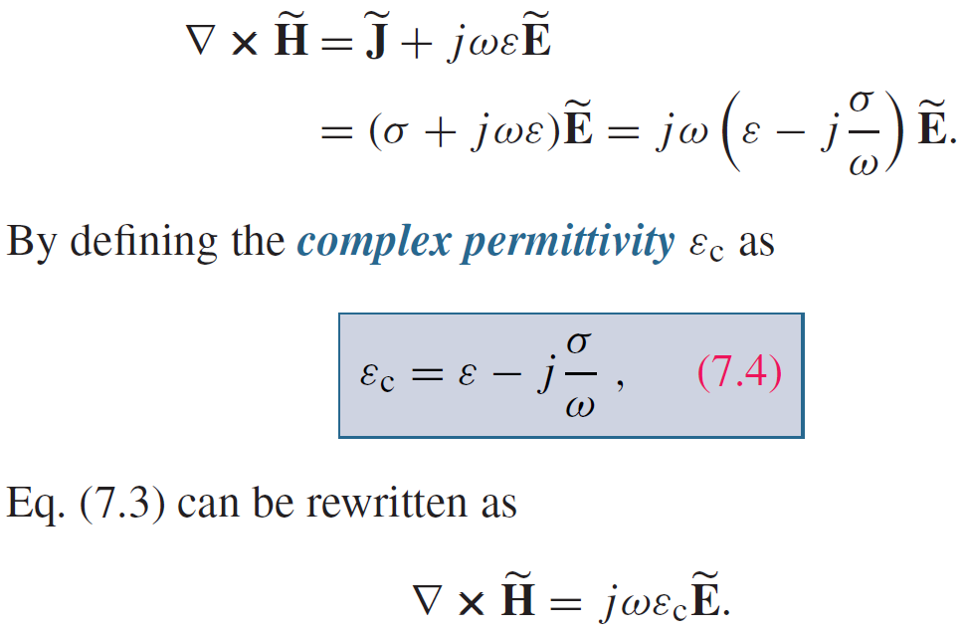
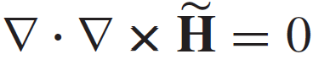
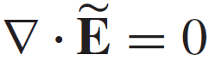
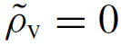
Maxwell’s Equations
For any vector field:
Hence:
and

Slide 7
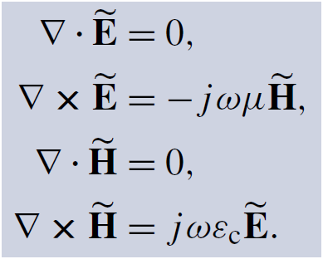
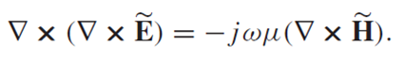
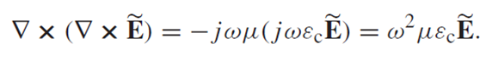
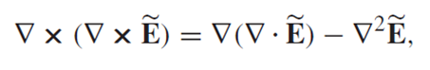
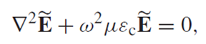
Wave equation

Slide 8
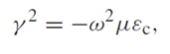
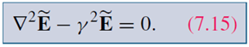
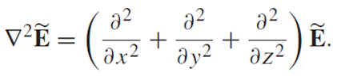
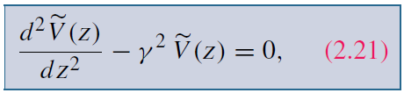
Compare t-line wave equation
In one dimensional case

Slide 9
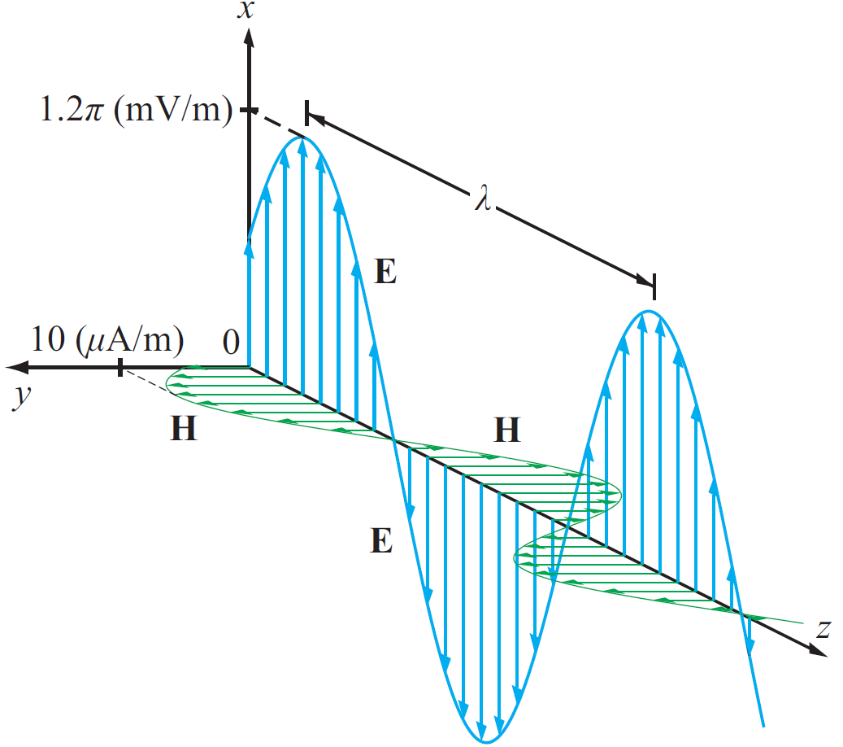
Solution in One Dimension

Slide 10
Review
EEC 130A Introductory Electromagnetics I

Slide 11
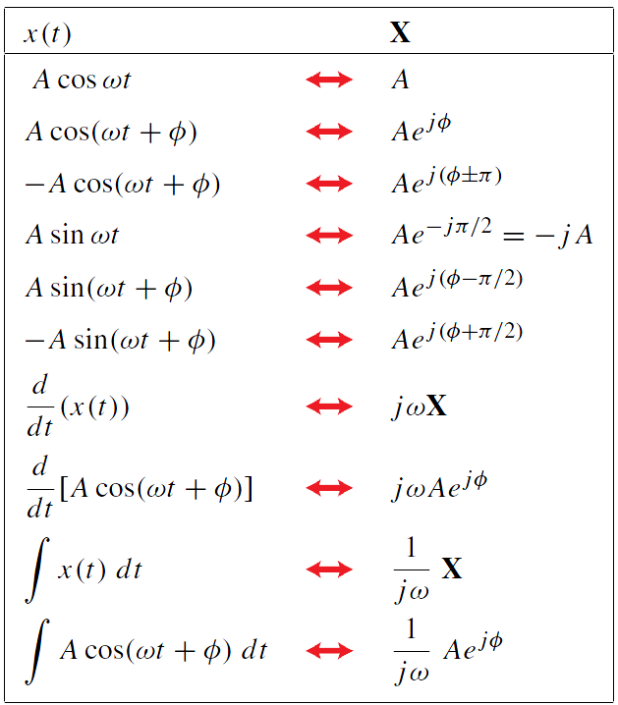
Waves
Waves
Phasor representation

Slide 12
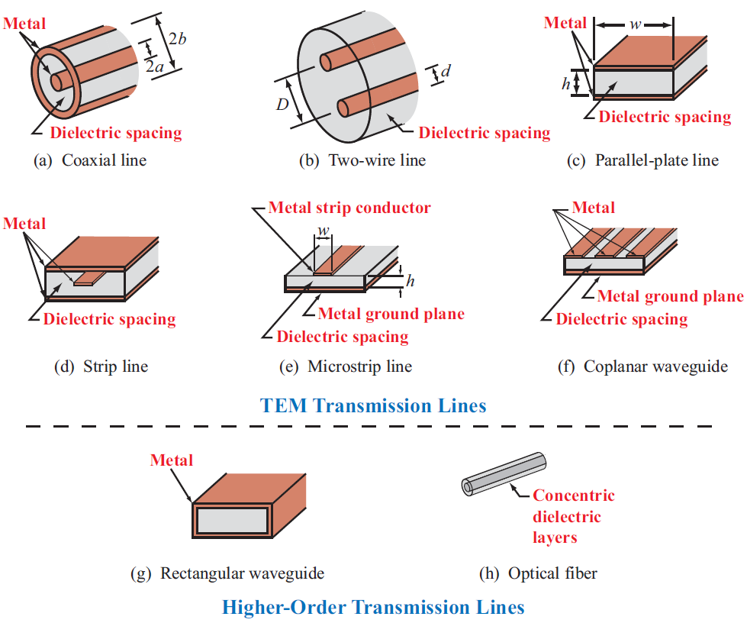
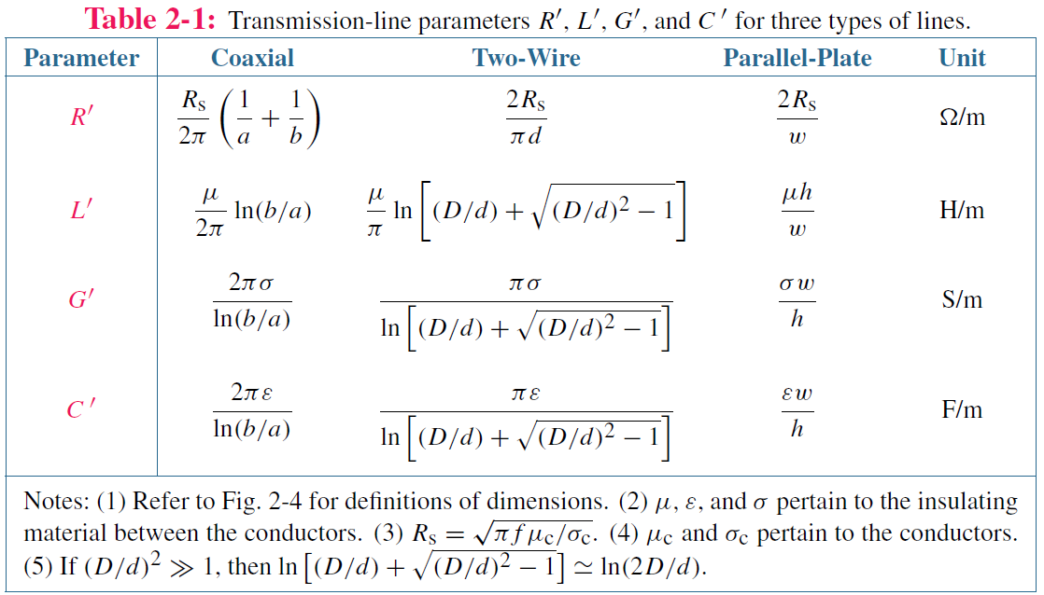
Transmission Lines
Transmission Line Examples

Slide 13
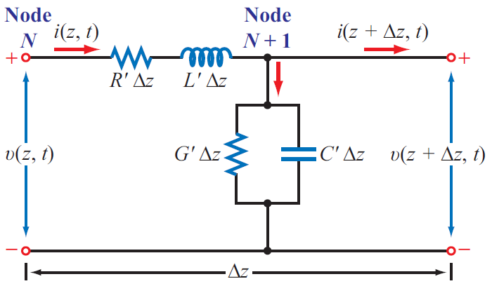
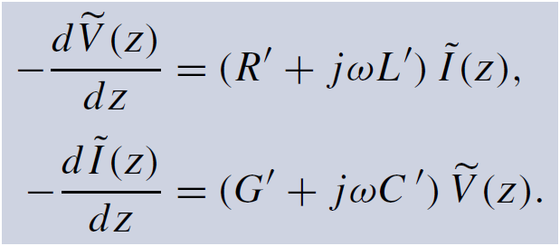
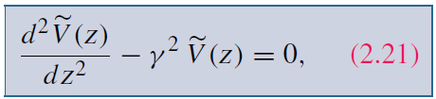
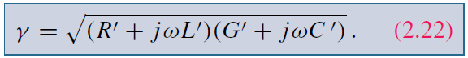
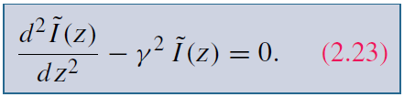
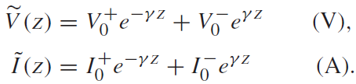
Transmission Lines
Telegrapher’s equations
Wave equation

Slide 14
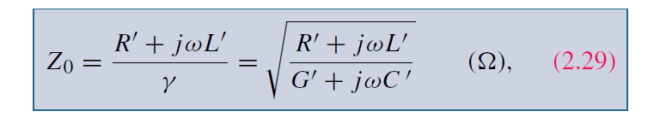
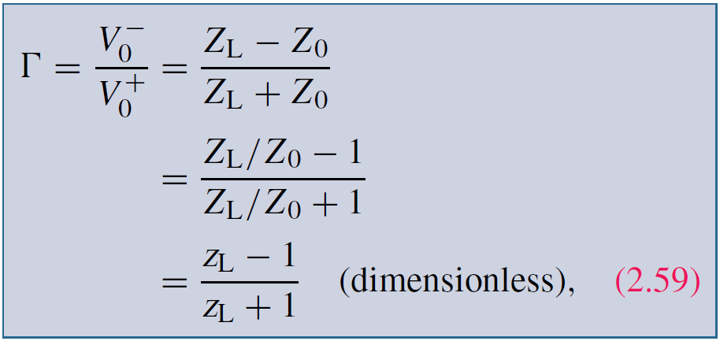
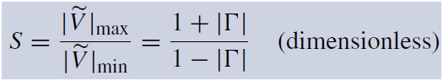
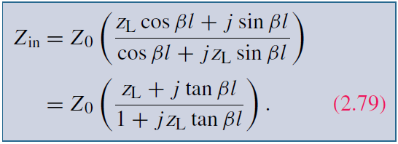
Transmission Lines
Characteristic impedance
Reflection coefficient
VSWR
Input impedance

Slide 15
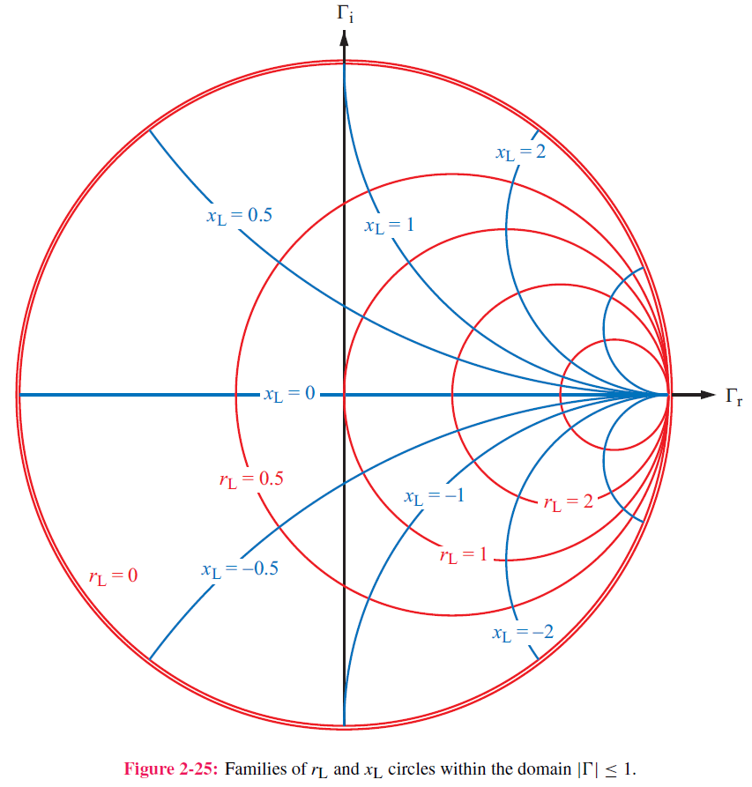
Transmission Lines
Smith chart

Slide 16
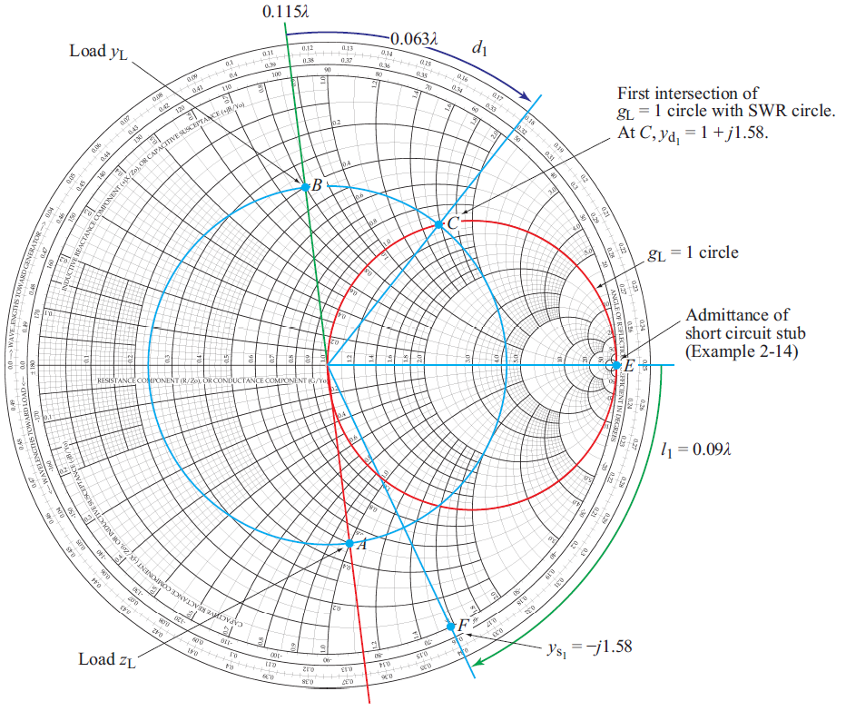
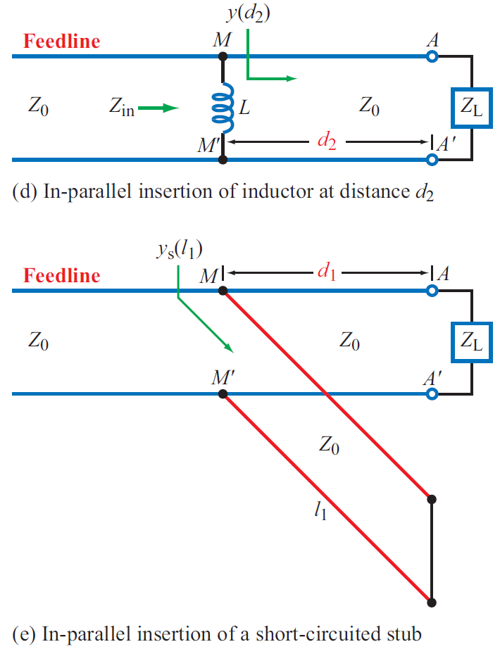
Transmission Lines
Impedance matching
λ/4 transformer
Lumped element
Single short stub

Slide 17
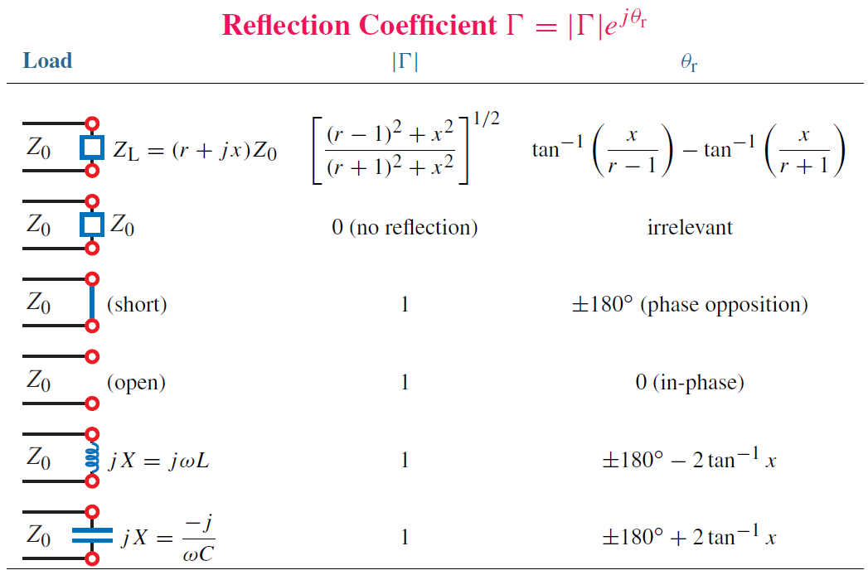
Transmission Lines
Special cases of T-lines

Slide 18
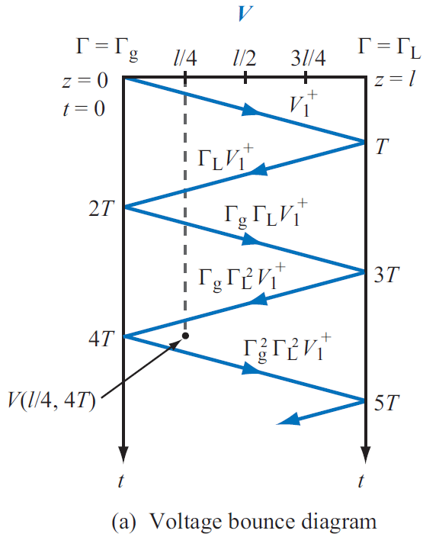
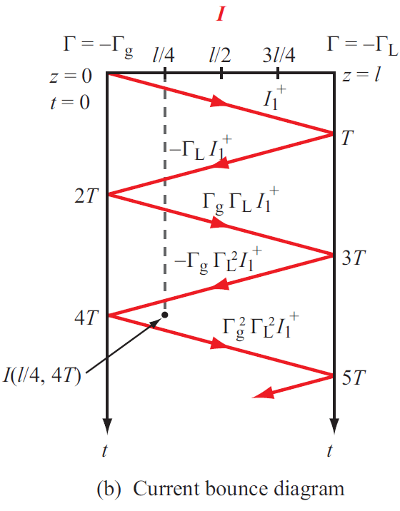
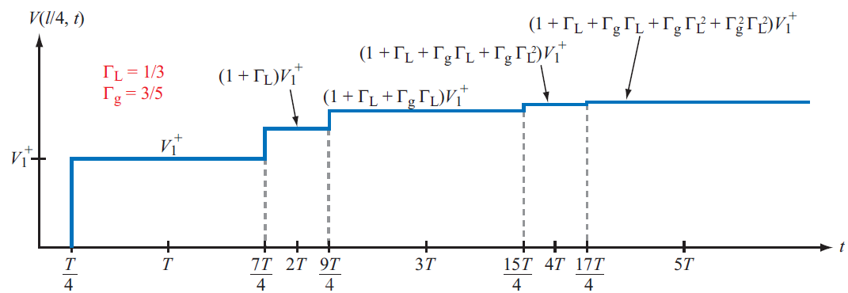
Transmission Lines
Transients, Bounce diagram

Slide 19
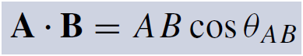
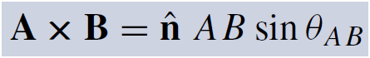
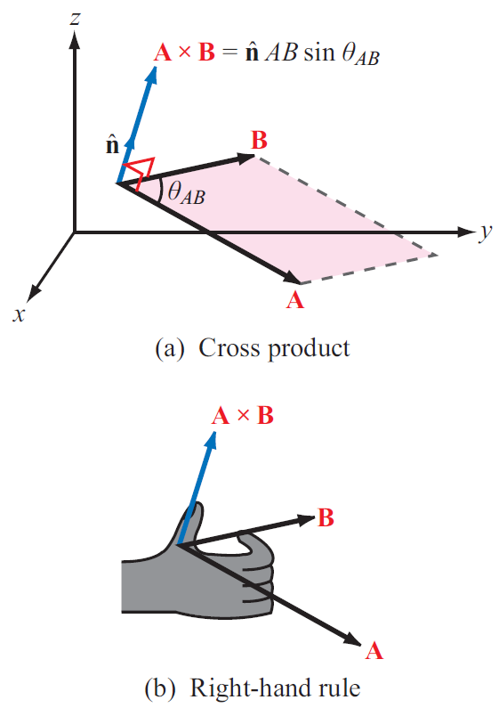
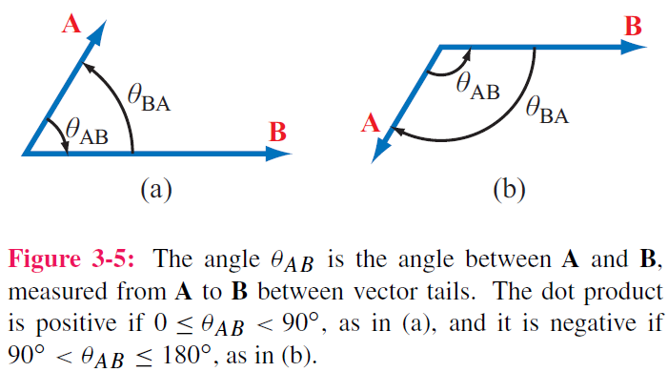
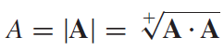
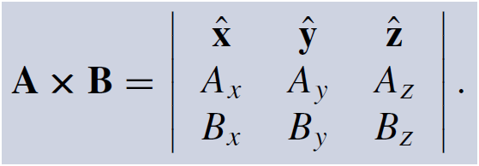
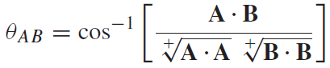


Vector Analysis
Dot Product -> Scalar
Cross Product -> Vector

Slide 20




Vector Analysis
Coordinate systems

Slide 21

Vector Analysis
Gradient

Slide 22


Divergence
Scalar -> Vector

Slide 23


Curl

Slide 24



Vector Analysis
Laplacian operator
Laplacian of a Scalar Field
Laplacian of a Vector Field
Useful Relation

Slide 25

Vector Analysis
Divergence Theorem
Useful tool for converting integration over a volume to one over the surface enclosing that volume, and vice versa

Slide 26

Vector Analysis
Stokes’s Theorem

Slide 27






Electrostatics
Coulomb’s law
Electric field at point P due to single charge
Electric force on a test charge placed at P
Electric flux density D

Slide 28



Gauss’s Law

Slide 29




Electrostatics
Electric scalar potential

Slide 30





Electrostatics
Conductors Dielectrics

Slide 31


Electrostatics
Boundary conditions

Slide 32


Electrostatics
Capacitance

Slide 33



Electrostatics
Electrostatic potential energy density
Energy stored in a capacitor
Total electrostatic energy stored in a volume

Slide 34



Magnetostatics
Force
Torque

Slide 35





Magnetostatics
Biot-Savart Law

Slide 36




Magnetostatics
Ampere’s Law (statics)

Slide 37



Magnetostaics
Magnetic Vector Potential A

Slide 38



Magnetostatics
Magnetic properties of materials

Slide 39




Magnetostatics
Boundary conditions

Slide 40




Magnetostatics
Inductance
Magnetic Flux
Flux Linkage
Inductance

Slide 41

Magnetostatics
Magnetic energy density

Slide 42


Maxwell’s Equations -- Dynamics
Faraday’s Law
Changing magnetic field induces electric field
Keyword is CHANGE
Lenz law

Slide 43
Maxwell’s Equations -- Dynamics
Ampere’s Law
Changing electric field induces magnetic field
Displacement current (does not necessarily involve charges)

